Slide 1
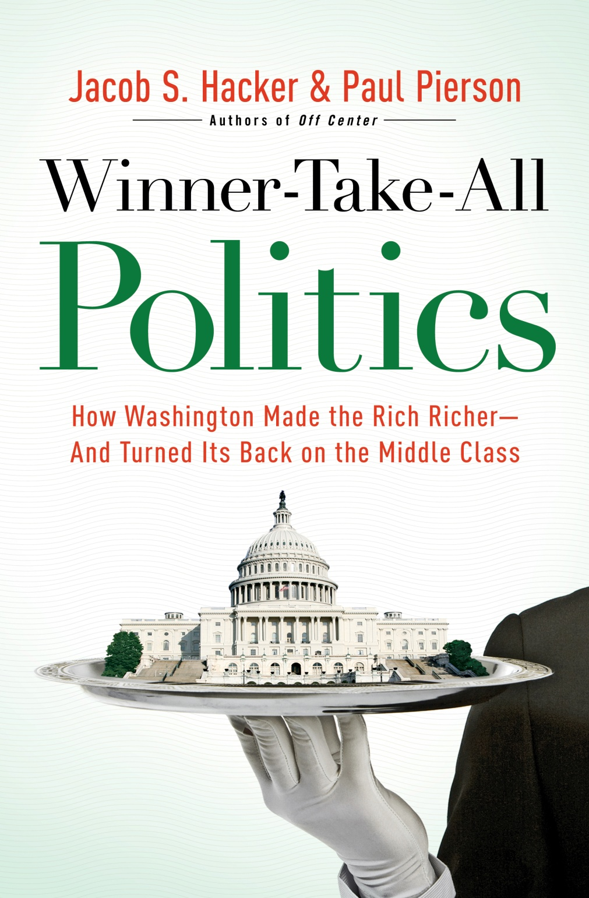

Slide 2
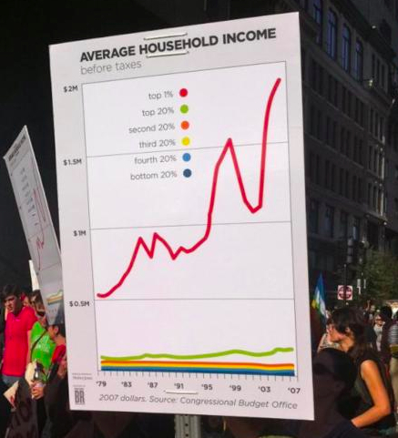

Slide 3
Average Income
(After taxes, including public
and private benefits; 2007 dollars)

Slide 4
Top 1 %’s Share (Excl. Capital Gains)

Slide 5
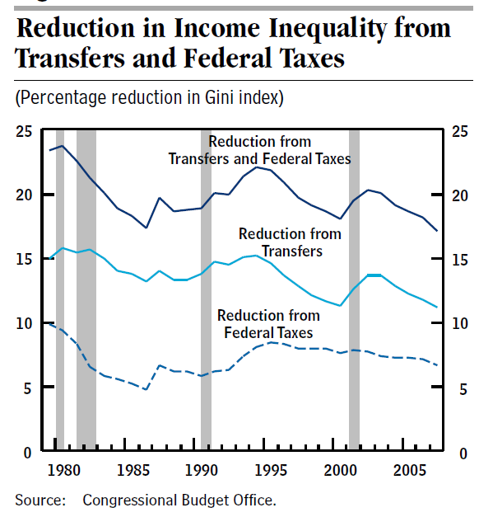

Slide 6
Declining Progressivity at the Top

Slide 7
Source: Thomas Philippon and Ariell Reshef, “Wages and Human Capital in the U.S. Financial Industry: 1909-2006,December 2008

Slide 8
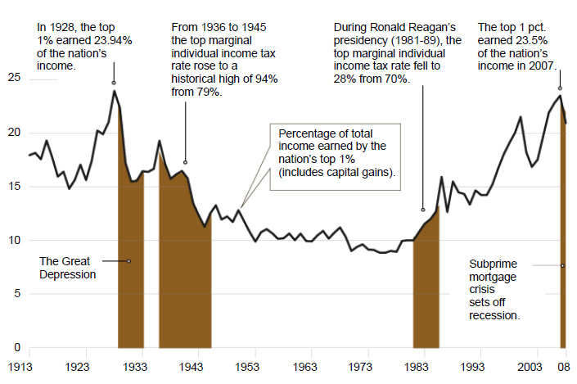

Slide 9
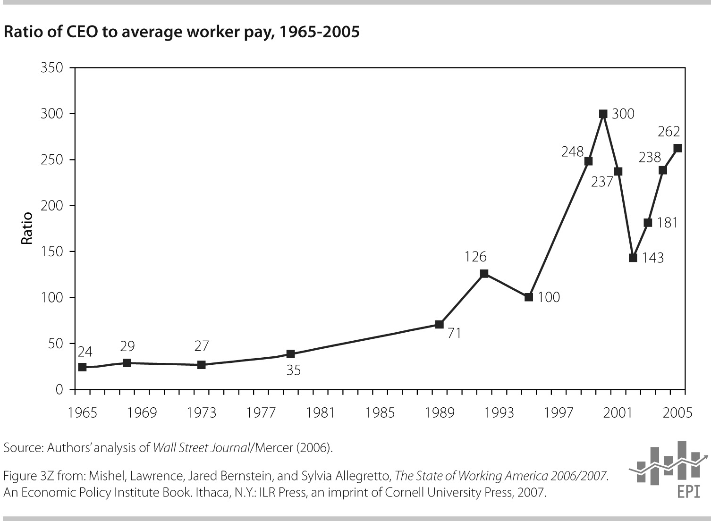

Slide 11
“In all cases where justice or the general good might require new laws to be passed, or active measures to be pursued, the fundamental principle of free government would be reversed. It would be no longer the majority that would rule: the power would be transferred to the minority.”
—James Madison, Federalist #58

Slide 12
http://www.leedrutman.com/uploads/2/3/0/1/2301208/explaining_the_growth_of_corporate_political_activity.pdf

Slide 13
“Unequal Polarization,” 1975-2010
Source: D-W Nominate Scores (1st dimension), www.voteview.org

Slide 14
Actual vs. Ethical Inequality (ISSP 1999)
 | Gini Index of Perceived Earnings Differences (How Much Inequality Is There?) | Gini Index of Normative Earnings Differences (How Much Inequality Should There Be?)
U.S. | 0.43 | 0.35
Europe | 0.47 | 0.34

Slide 16
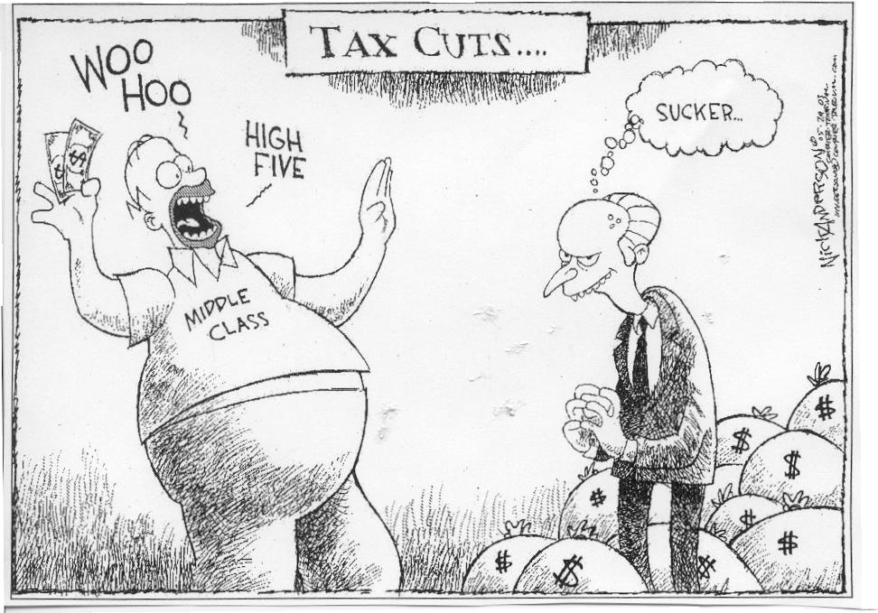

Slide 17
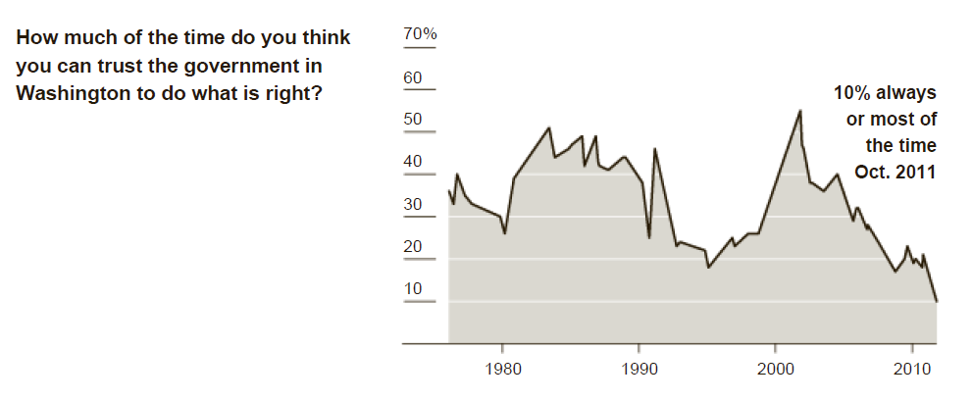
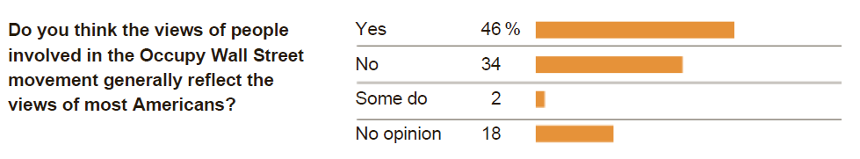
Source: NYT/CBS News Poll, October 19-24, 2011, n=1650

Slide 18
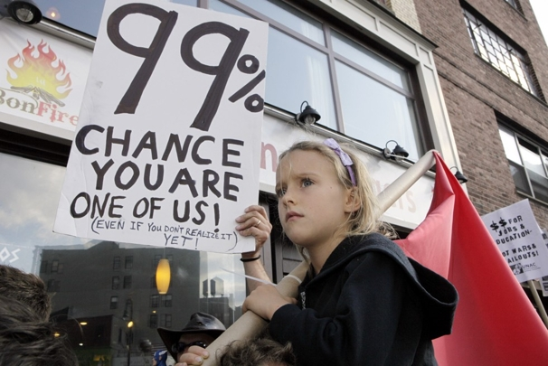

Slide 19
Supplemental Slides

Slide 20
How much more (or less) would each income group have received in 2005 if income had grown at the same rate for all groups from 1979 to 2005? (Negative numbers in red.)
Income group | Difference in average income per household (actual income minus income assuming equal growth) | Total income difference for group (difference in average income times number of people in group)
Bottom fifth | $5,623 richer per household | $136 billion richer as a group
Second fifth | $8,582 richer | $189 billion richer
Middle fifth | $10,100 richer | $224 billion richer
Third fifth | $8,598 richer | $194 billion richer
Next tenth | $3,733 richer | $43 billion richer
Next 5 percent | $4,912 poorer | $29 billion poorer
Next 4 percent | $29,895 poorer | $140 billion poorer
Top 1 percent | $597,241 poorer | $673 billion poorer

Slide 21
Rising inequality “is simply an economic reality, and it is neither fair nor useful to blame any political party.”
—Henry Paulson

Slide 22
What accounts for rising inequality? Some pundits are tempted to look inside the Beltway for a cause, but the case is hard to make. Government policy makers do not have the tools to exert such a strong influence over pretax earnings, even if they wanted to do so.
—Greg Mankiw

Slide 23
I can’t see the mechanism by which changes in government policies bring about such huge swings in pre-tax income distribution.
—Brad DeLong

Slide 24
“The government of the democracy is the only one under which the power that votes the taxes escapes the payment of them.”
—Alexis de Tocqueville
Democracy in America
Notes:
Median voter model comes from deToque. (LUCKY DUCKIES)

Slide 25
“Wherever there is great property, there is great inequality….Civil government, so far as it is instituted for the security of property, is in reality, instituted for the defence of the rich against the poor, or of those who have some property against those who have none at all.”
—Adam Smith
The Wealth of Nations
Notes:
Wait for it…

Slide 26
The Rise of the Top 1%, 1960-2006

Slide 27
The Top 1%* in Affluent Democracies
* excluding capital gains

Slide 28
The Top 1%* in the U.S. and Sweden
* excluding capital gains

Slide 29
“Unequal Polarization,” early 1970s-early 2000s
Source: Poole-Rosenthal, D-W Nominate Scores

Slide 30
Declining Redistribution
Source: Thomas Hungerford, CRS; PSID and CNEF
Notes:
And yet, the trends of the last generation have been exactly the opposite. Redistribution through government taxes and transfers—the most visible and easily assessed form of redistribution that is the focus of the median-voter argument just outlined—has actually declined. Between 1980 and 2003, according to a recent analysis using the Panel Study of Income Dynamics, the amount by which government taxes and benefits reduced inequality (as measured by the Gini index, a common inequality standard) fell by roughly a third (Hungerford 2008). Inequality in what people earn rose. But instead of offsetting this rise, government taxes and benefits actually exacerbated it—an outcome seen in virtually no other nation (Mahler and Jesuit 2006).
This is even more clear when we look beyond the highly visible redistribution that occurs through government taxes and benefits and consider the myriad less visible ways in which government has shaped the market to favor of those at the top. In a range of areas from executive compensation and financial market regulation to laws governing the formation of unions, there is overwhelming evidence that political elites have shifted laws in a manner that has have abetted the rise in top incomes, through both new enactments and the deliberate failure to update policy to reflect changing social circumstances (Hacker and Pierson forthcoming). Instead of pushing back against rising inequality, in other words, government has pushed forward.

Slide 31
Declining Progressivity at the Top

Slide 32
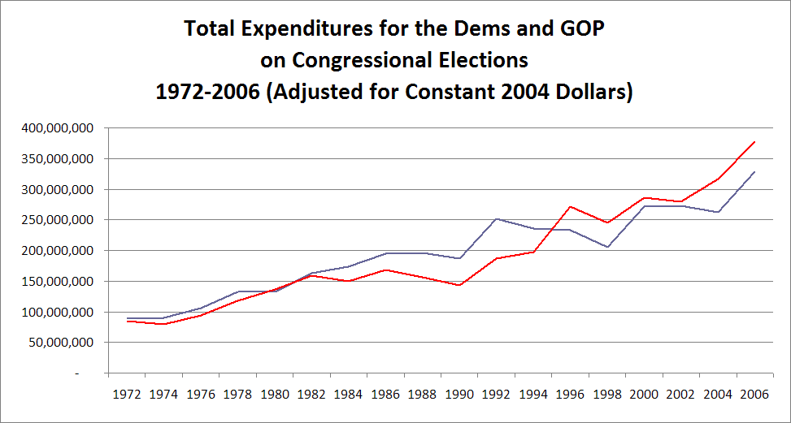

Slide 33
Contacting by Democratic Party
Source: Andrea Campbell, “Parties, Electoral Participation, and Shifting Voting Blocs,” in The Transformation of American Politics (Princeton, 2007).
Notes:
Mention that source=Campbell and fact that nonseniors

Slide 34
Contacting by Republican Party
Source: Andrea Campbell, “Parties, Electoral Participation, and Shifting Voting Blocs,” in The Transformation of American Politics (Princeton, 2007).

Slide 35
Support for Redistribution vs. Security
 |  | Attitude Toward Government Redistribution
 |  | Oppose |  | Favor
Attitude Toward Government Providing Economic Security | Oppose | 36.7% |  | 5.0%
 | Favor | 21.4% |  | 13.2%

Slide 36
Support for Redistribution vs. Security (Information Given About Current Distribution of Income)
 |  | Attitude Toward Government Redistribution
 |  | Oppose | Favor
Attitude Toward Government Providing Economic Security | Oppose | 22.9% | 23.5%
 | Favor | 19.9% | 33.7%

